Slide 1









T1: Introduction to Scientific Computing: Python – Numpy and Matplotlib
Alice Baird
alice.baird@informatik.uni-augsburg.de
Deep Learning – EIHW – University Augsburg

Slide 2
Agenda
1
Python
2
NumPy
3
Matplotlib
4
Exercise

Slide 3
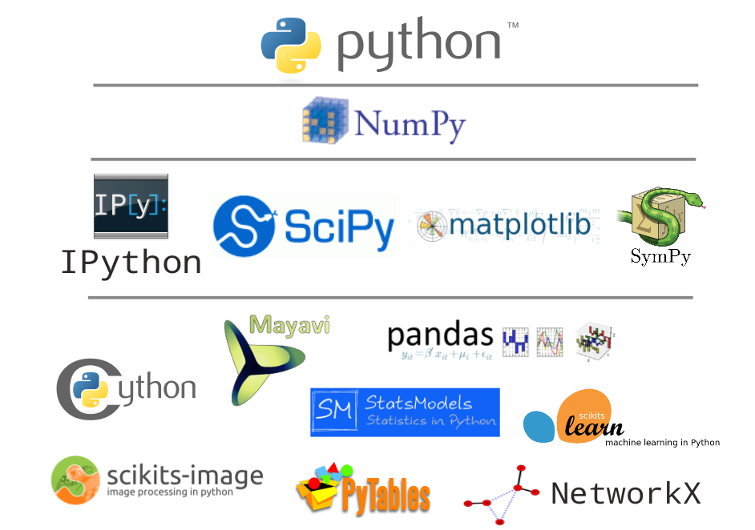
Python
Why Python?
Free and open source
Simple syntax
High-level language
Object oriented
Cross-platform
Widely supported
Active community

Slide 4
Python
IDE-Setup: Anaconda
Package includes a plethora of python libraries:
NumPy
Pandas
Scipy
iPython/Jupyter Notebook
Matplotlib
More information and material:
https://www.anaconda.com
https://www.python.org/

Slide 5
NumPy
Numpy is a library for the Python programming language, adding support for large, multi-dimensional arrays and matrices, along with a large collection of high-level mathematical functions to operate on these arrays.

Slide 6
NumPy
What is NumPy?
NumPy is a Python C extension library for array-oriented computing
Efficient in-memory
Homogeneous (but types can be algebraic)
NumPy is suited to many applications
Image/ Signal processing
Linear Algebra
Signal element of data-type (dtype)
0 | 1 | 2 | 3 | 4 | 5 | 6 | 7 | 8

Slide 7
NumPy
NumPy Ecosystem
NumPy is the foundation of the python scientific stack
librosa
OpenCV
numexpr
astropy
PyTabes
statsmodels
Biopython
Scikit-image
scikit-learn
Numba
Scipy
Pandas
Matplotlib
NumPy

Slide 8
NumPy
Array Shape
0 | 1 | 2 | 3 | 4
One dimensional arrays have a 1-tuple for their shape
Shape: (5,)
Two dimensional arrays have a 2-tuple
Shape: (3,5)
Three dimensional arrays have a 3-tuple
Shape: (3,5,3)
0 | 1 | 2 | 3 | 4
5 | 6 | 7 | 8 | 9
10 | 11 | 12 | 13 | 14
0 | 1 | 2 | 3 | 4
5 | 6 | 7 | 8 | 9
10 | 11 | 12 | 13 | 14
0 | 1 | 2 | 3 | 4
5 | 6 | 7 | 8 | 9
10 | 11 | 12 | 13 | 14
0 | 1 | 2 | 3 | 4
5 | 6 | 7 | 8 | 9
10 | 11 | 12 | 13 | 14

Slide 9
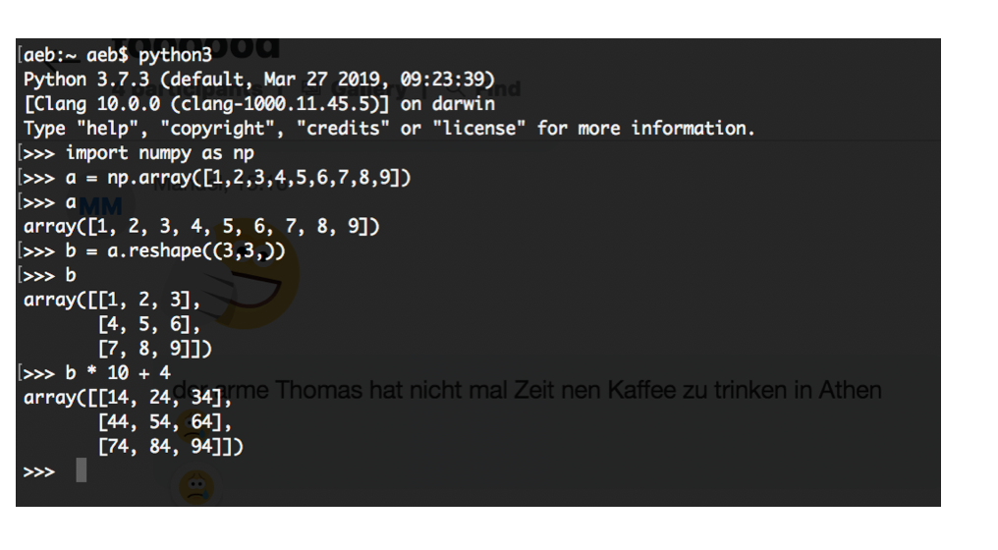
NumPy
Getting started
$ Python3
>>> Import numpy as np
>>> A = np.array([1,2,3,4])
>>> A2 = A.reshape(2,2)
>>> A2
array([[1, 2],
[3, 4]])
>>> A3 = np.array([A2,A2,A2])
array([[[1, 2],
[3, 4]],
[[1, 2],
[3, 4]],
[[1, 2],
[3, 4]]])

Slide 10
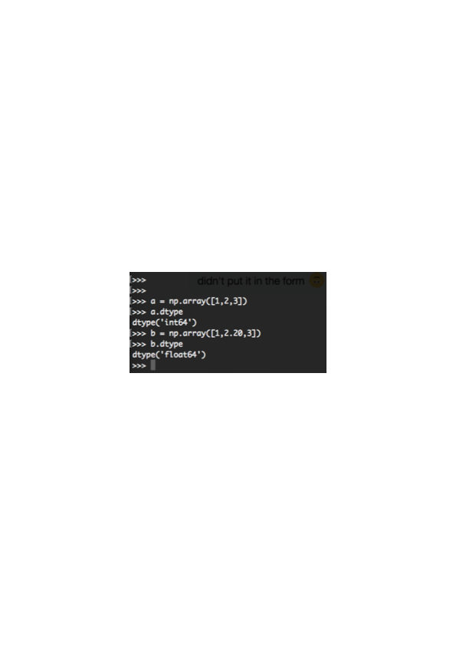
NumPy
Array Element Types
NumPy arrays comprise elements of a single data type
The type object is accessible through the .dtype attribute
Here are a few of the most important attributes of dtype objects
dtype.byteorder – big or little endian
dtype.itemsize – element size of this dtype
dtype.name – a name for this dtype object
Dtype.type – type object used to create scalers

Slide 11
NumPy
To follow..
>>> v1 = np.array([0, 1, 2, 3, 4])
>>> v2 = np.array([0,1,2,3,4,5,6,7,8,9,10,11,12,13,14])
>>> v2 = v2.reshape((3,5,))
>>> v3 = np.array([v2,v2,v2])

Slide 12
NumPy
k
Indexing arrays
In 1 dimension
V1[1] = 1
In 2 dimensions
V2[1,1] = 6
V2[1][1] = 6
Only a row from a 2D array
V2[1] = ([5,6,7,8,9])
Only a column from a 2D array
V2[:, 1] = ([1,6,11])
In 3 dimensions (i,j,k)
V3[2,0,2] = 2
3D row
V3[1, 1] = ([5,6,7,8,9])
3D column
V3[0, :, 1] = ([1,6,11])
0 | 1 | 2 | 3 | 4
0 | 1 | 2 | 3 | 4
5 | 6 | 7 | 8 | 9
10 | 11 | 12 | 13 | 14
j
0 | 1 | 2 | 3 | 4
5 | 6 | 7 | 8 | 9
10 | 11 | 12 | 13 | 14
k
0 | 1 | 2 | 3 | 4
5 | 6 | 7 | 8 | 9
10 | 11 | 12 | 13 | 14
0 | 1 | 2 | 3 | 4
5 | 6 | 7 | 8 | 9
10 | 11 | 12 | 13 | 14
j
i

Slide 13
NumPy
Slicing arrays
0 | 1 | 2 | 3 | 4
In 1D
V1[1:3] = 1,2
Inclusive : exclusive
In 2D (k,j)
V2[1:,1:2] = ([[6],[11]])
In 3D (i,j,k)
V3[1:3,:,:2] =
0 | 1 | 2 | 3 | 4
5 | 6 | 7 | 8 | 9
10 | 11 | 12 | 13 | 14
k
0 | 1 | 2 | 3 | 4
5 | 6 | 7 | 8 | 9
10 | 11 | 12 | 13 | 14
0 | 1 | 2 | 3 | 4
5 | 6 | 7 | 8 | 9
10 | 11 | 12 | 13 | 14
0 | 1 | 2 | 3 | 4
5 | 6 | 7 | 8 | 9
10 | 11 | 12 | 13 | 14
j
i

Slide 14
NumPy
Universal functions (ufuncs)
a
0 | 1 | 2 | 3 | 4
Comparison: <, <=, ==, !-, >=, >
Arithmetic: +, -, *, /, recirocal, square
Exponetial: exp, expml, exp2, log, log10, log1p, log2, power, sqrt
Trigonometric: sin, cos, tan, acsin, arccos, atctan
Hyperbolic: sinh, cosh, tang, acsing, arcosh, atctanh
Bitwise operations: &, |, ~, left_shit, right_shift
Logical operations: and, logical_xor, not, or
Preidcates, isfinite, isinf, isnan, signbit
Other: abs, ceil, floor, mod, modf, round, sinc, sign, trunc
b
0 | 1 | 2 | 3 | 4
c = a + b
c
0 | 2 | 4 | 6 | 8

Slide 15
NumPy
Broadcasting
Arrays with different, but compatible shapes can be used as arguments to ufuncs
c = a + 10
Array scalar is broadcast to an array with shape (5,)
f = d + e
Array of shape (3,1) is broadcast to an array of shape (3,3)
a
0 | 1 | 2 | 3 | 4
10 | 10 | 10 | 10 | 10
c
10 | 11 | 12 | 13 | 14
0 | 1 | 2
3 | 4 | 5
6 | 7 | 8
d
1 | 2 | 3
5 | 6 | 7
9 | 10 | 11
f
1
2
3
e

Slide 16
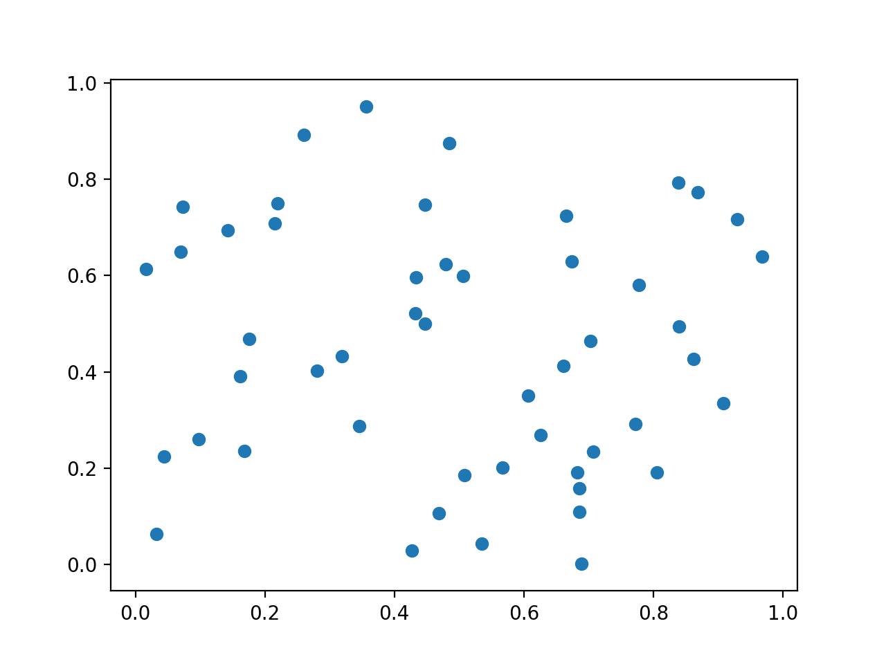
Matplotlib
Why Data Visualisation ?
Typically the human brain is more easily able to process information in a graphical form.
Visualisation for a fast and comparable interpretation of variables
X = array([[0.21931611],
[0.83822659],
[0.03256711],
[0.96840084],
[0.42651861],
[0.21550177],
[0.70717934],
[0.48524399],
[0.84014719],
[0.2804971 ],
[0.3562661 ],
[0.50785364],
[0.77293316],
[0.47939394],
[0.07281517],
[0.17597196],
[0.90858472],
[0.67431596],
[0.66159206],
[0.26029087],
[0.6893011 ],
[0.50652253],
[0.4325244 ],
[0.86211818],
[0.43336198],
[0.53473582],
[0.68560849],
[0.01609683],
[0.92965087],
[0.09711111],
[0.80520133],
[0.14279456],
[0.68592087],
[0.44764685],
[0.62588539],
[0.68284297],
[0.70308722],
[0.44747923],
[0.16215412],
[0.3452338 ],
[0.6064216 ],
[0.66584489],
[0.56663805],
[0.04397835],
[0.06954956],
[0.31945358],
[0.77817736],
[0.8689392 ],
[0.16835546],
[0.46908336]])
Y =array([[0.74936574],
[0.79258384],
[0.06382664],
[0.63906225],
[0.02960675],
[0.70849428],
[0.23447195],
[0.87444149],
[0.49482896],
[0.4019388 ],
[0.95039339],
[0.18576771],
[0.29146152],
[0.62398151],
[0.74295998],
[0.46837823],
[0.33560226],
[0.63003699],
[0.41267455],
[0.892257 ],
[0.00162714],
[0.59887539],
[0.52160887],
[0.42736936],
[0.59611896],
[0.04349762],
[0.10889983],
[0.61417486],
[0.71631042],
[0.2598101 ],
[0.19144972],
[0.69364723],
[0.15829926],
[0.74699998],
[0.26947397],
[0.19101634],
[0.46475356],
[0.50004881],
[0.39163537],
[0.28780942],
[0.35077044],
[0.72415303],
[0.20121398],
[0.22419878],
[0.64920682],
[0.43322217],
[0.5803156 ],
[0.77363282],
[0.2353177 ],
[0.10631033]])

Slide 17
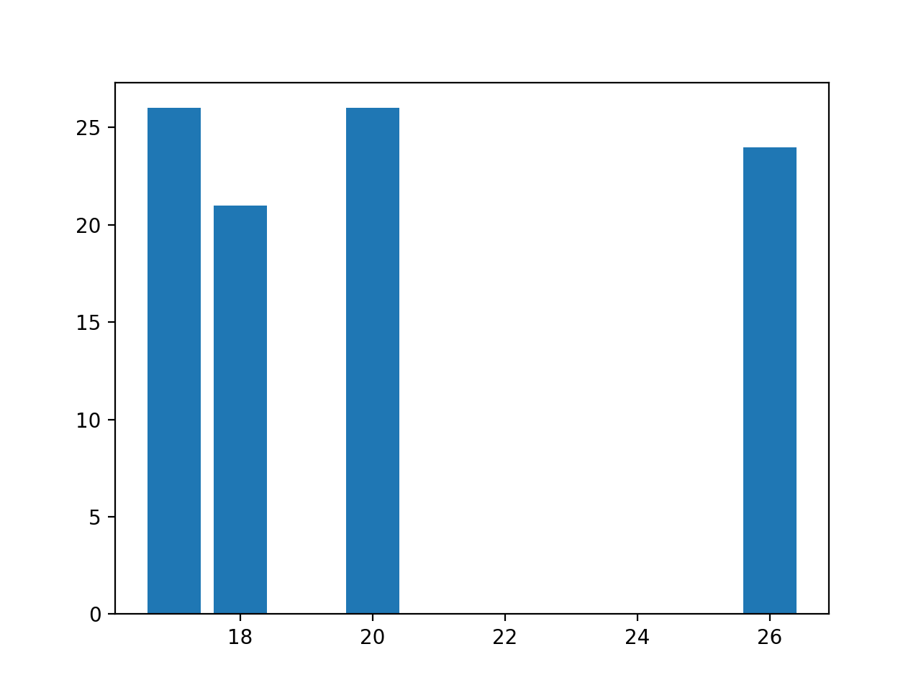
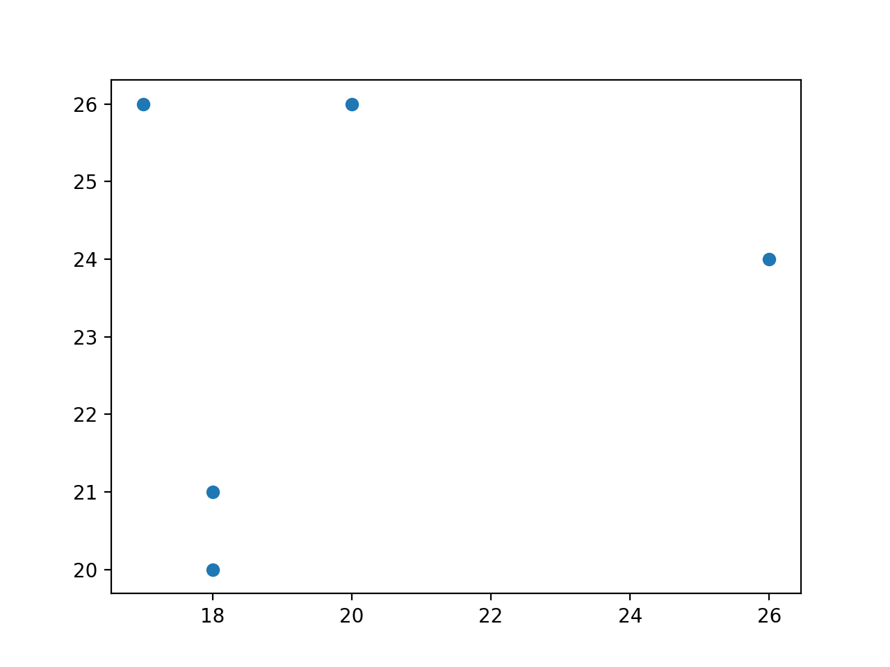
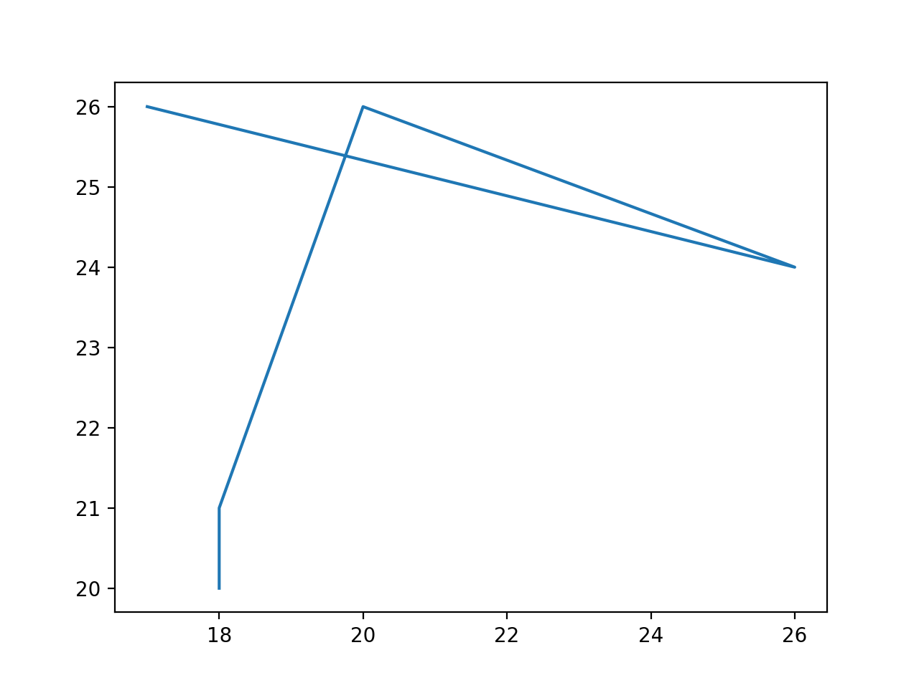
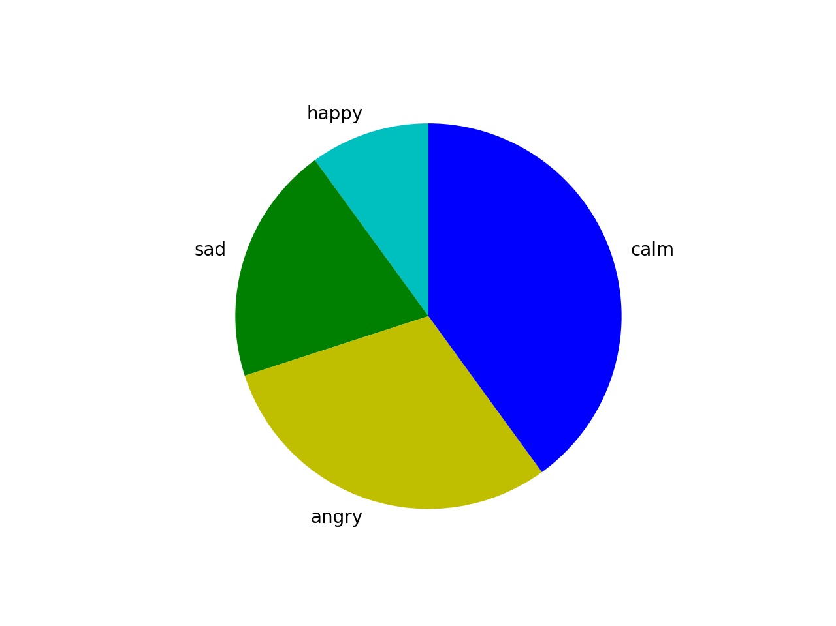
Matplotlib
What is Matplotlib
Matplotlib is a Python package used predominately for 2D graphics
Bargraphs, Histograms, Scatter Plot, Pie Plot, Hexagonal Bin Plot, Area Plot

Slide 18
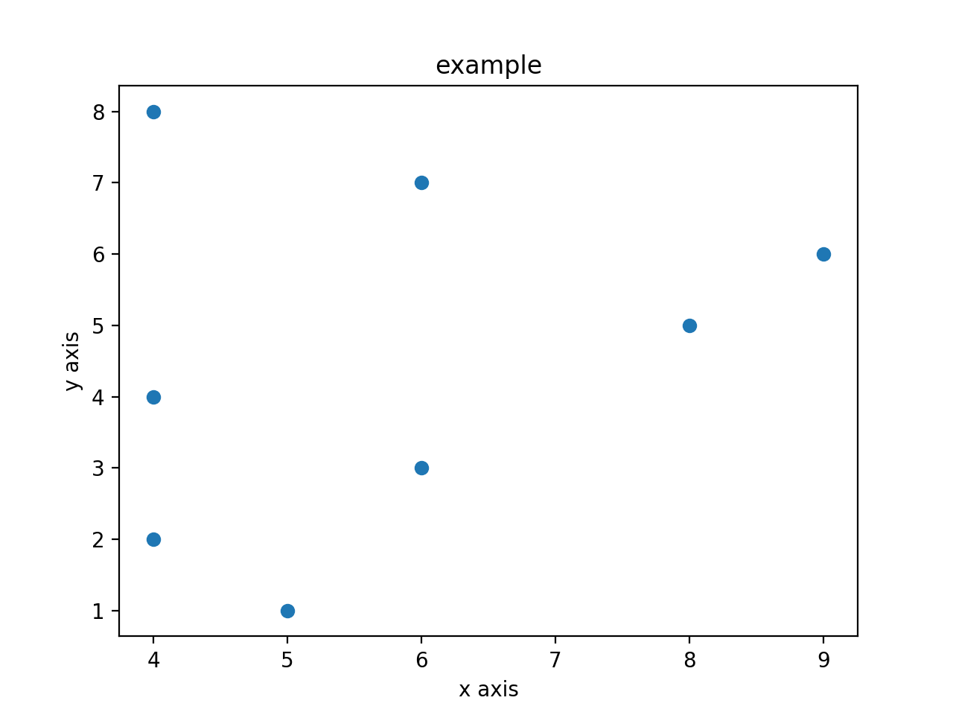
Matplotlib
Example
import matplotlib.pyplot as plt
x = [5,4,6,4,8,9,6,4]
y = [1,2,3,4,5,6,7,8]
plt.scatter(x,y)
plt.title('example')
plt.ylabel('y axis')
plt.xlabel('x axis')
plt.show()

Slide 19
Deep Learning (NumPy)
Online resources
Becominghuman.ai
Medium.com
Towardsdatascience.com
Hackeroon.com
Coursera - Deep Learning w/ Andrew Ng
http://www.deeplearningbook.org/

Slide 20
Excercise
Python / Numpy / Matplotlib
Exercise (DL-T1.ipynb)
Focused mostly on NumPy
Exercise Questions relate only to NumPy
Open the jupyter notebook that has been uploaded to digicampus
If you do not have jupyter please install it:
$ pip install jupyter
$jupyter notebook DL-T1.ipynb / dl_tut_insession01.ipynb

